Slide 1
RSA CRYPTOGRAPHY
LAVANYA MAGANTI
DIVYA MUSIRUGARI
BALA SHEKHAR REDDY
CHARISHMA MEDARMETLA

Slide 2
Cryptography (History)
Derived from Greek word “kryptós” which means, "hidden, secret"; and ”graphein” which means, "writing“.
The roots of cryptography are found in Roman and Egyptian civilizations.
Various analysis and attack techniques were researched to break the secret codes.
During the period of World War II, both cryptography and cryptanalysis became excessively mathematical.

Slide 3
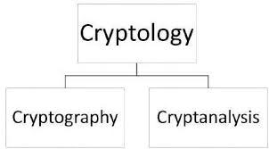
Cryptography
Definition: Cryptography is the art and science of making a cryptosystem that is capable of providing information security.
Technique used for secure communication.
Storing and transmitting data in a particular form so that only those for whom it is intended can read and process it.

Slide 4
Cryptography (Security Services/Primitives)
Security Services: Confidentiality Integrity Authentication Non Reputation

Slide 5
Cryptosystems (Types)
Definition : A cryptosystem is an implementation of cryptographic techniques and their accompanying infrastructure to provide information security services. A cryptosystem is also referred to as a cipher system.
There are two types of cryptosystems:
->Symmetric Key Encryption/Symmetric Cryptography
->Asymmetric Key Encryption/ Asymmetric Cryptography

Slide 6
Symmetric/private-key Cryptography
The encryption process where same keys are used for encrypting and decrypting the information is known as Symmetric Key Encryption.
Keys are recommended to be changed regularly to prevent any attack on the system.
Key length is smaller => process of encryption-decryption is faster than asymmetric key encryption.
Processing power of computer system required is less.
Key is disclosed => communications are compromised

Slide 7
Asymmetric/public-key Cryptography
The encryption process where different keys are used for encrypting and decrypting the information is known as Asymmetric Key Encryption.
uses two keys – a public key: to encrypt messages and
– a private key: to decrypt messages
Key length is large => process of encryption-decryption is slower than symmetric key encryption.
Processing power of computer system required to run asymmetric algorithm is higher.
complements rather than replaces private key cryptography

Slide 8
RSA Cryptography: HISTORY/RSA
The idea of an asymmetric public-private key cryptosystem is attributed to Whitfield Diffie and Martin Hellman, who published the concept in 1976.
Several attempts were made over the course of a year to create a one-way function that is hard to invert.
Finally, Rivest, Shamir & Adleman of MIT in 1977 invented RSA.

Slide 9
RSA Cryptography
Widely used public–key cryptosystems for secure data transmission.
Encryption key is public and differs from the decryption key which is kept secret.
Publishes a public key based on two large prime numbers which are kept secret.
If the public key is large enough, only someone with knowledge of the prime numbers can feasibly decode the message
Security due to cost of factoring large numbers

Slide 10
RSA Prime Numbers Generation (Fermat Primality Test)
User needs to generate to large primes p and q:
Number a is said to be co-prime to p if gcd(a , p)=1
Fermat’s theorem:
For every prime p and every a co-prime to p
(1 < a < p)
a^{p-1} ≡ 1 (mod p)
If equality fails then the generated number is not prime.
Fermat test is used to determine whether the given integer is prime or not.

Slide 11
RSA-KEY Generation
User generates a public/private key pair by:
selecting two large primes at random - p, q
computing their modulus N=p.q
Note: [ m=(p-1)(q-1) ]
selecting a random encryption key e
where [ 1<e< m, gcd(e, m)=1]
solve following equation to find decryption key d
[e*d=1 mod m and 0≤d≤N ]
publish their public encryption key: {e, N}
keep secret private decryption key: {d, p, q}

Slide 12
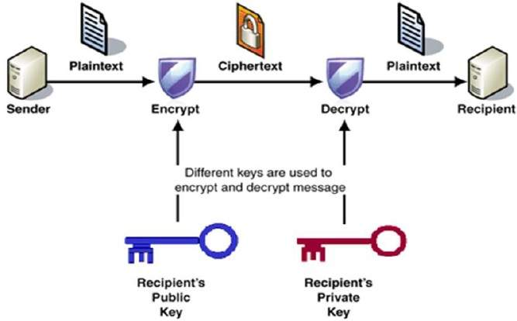

Slide 13
RSA Encryption/Decryption
Sender A does the following:-
Obtains the recipient B’s public key {n,e}.
Represents the plaintext message as a positive integer M, 1< M <n
Computes the cipher text c = Me mod n
Sends the cipher text c to B
Receiver B does the following:-
Uses his private key (n,d) to compute M = c^{d} mod n
Extracts the plaintext from the message M.

Slide 14
Algorithm
Generate two random large primes p and q
Calculate n such that n = pq
Compute m = (p-1)(q-1)
Choose random encryption key e, such that 0 < e < m and gcd(e, m) =1
Calculate decryption key d using d=e⁻¹mod m
Generate cipher text c using c = Me mod n, 1<m<n
Decrypt the cipher text c using M = c^{d} mod n, to get original message M

Slide 15
Code (modular exponentiation)
public static BigInteger modexp(BigInteger chunk, String e, BigInteger n)
{
String Result;
BigInteger d=BigInteger.valueOf(1);
for(int z=0;z<e.length();z++)
{
Result=String.valueOf(e.charAt(z));
d=d.multiply(d);
if(Result.equals("1"))
{
d=d.multiply(chunk).mod(n);
}
}
return d;
}// modexp function

Slide 16
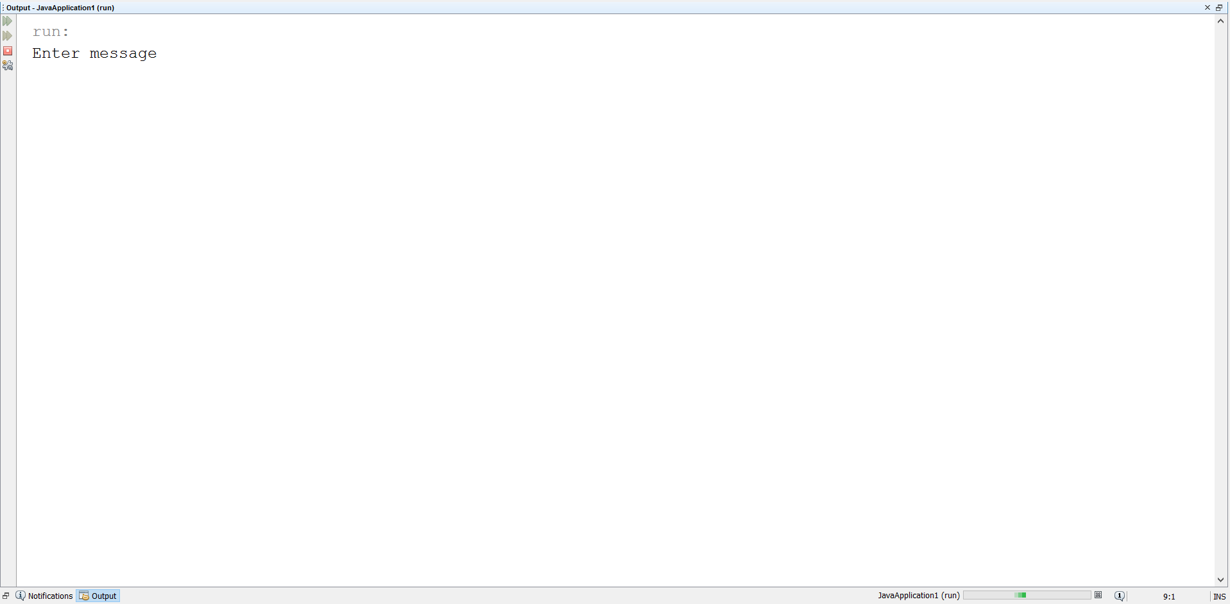
RSA Execution Screen Shots

Slide 17
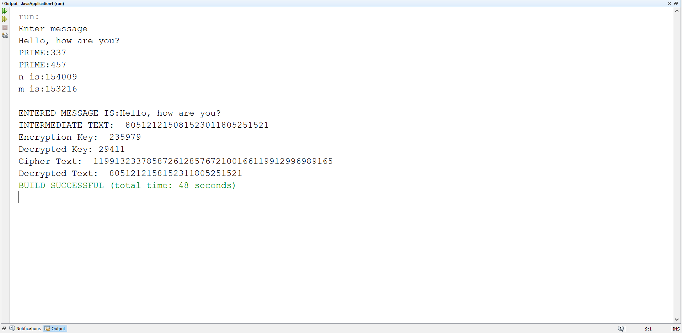
RSA Execution Screen Shots

Slide 18
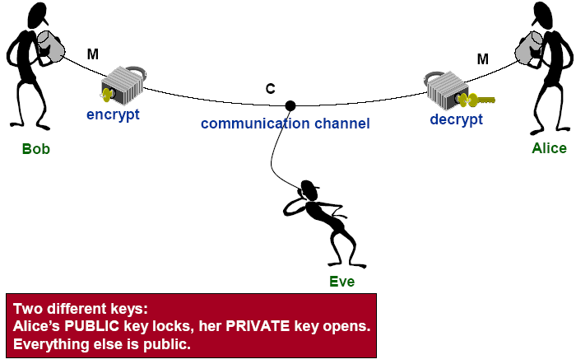
RSA Security
Possible approaches to attack RSA are:
Brute force key search
Mathematical attacks
Timing attacks

Slide 19
Brute Force Key Search/Exhaustive Key Search
A cryptanalytic attack used to decrypt any encrypted data.
Involves trying all possible private keys.
A cipher text with a key length of N bits can produce 2^{N} possible keys.
Difficulty of brute force attack is directly proportional to the size of the key.
Ways to mitigate Brute force attacks
The data to be unclear.
Changing a key frequently.

Slide 20
Mathematical Attack
It is based on difficulty of computing m, by factoring modulus n.
There are several approaches, to find the product of two primes.
mathematical approach takes 3 forms:
factor n=p*q, hence compute m and then d
determine m directly and compute d
find d directly

Slide 21
Timing/Side Channel Attack
A timing attack is a form of implementation attack.
Kocher described this attack on RSA in 1995
Attacker attempts to compromise a cryptosystem by analyzing the time taken to execute cryptographic algorithms.
One way to thwart these attacks is to ensure that the decryption operation takes a constant amount of time for every cipher text.
Timing attacks are practical in many cases:
Timing attacks can be applied to any algorithm that has data-dependent timing variation.
Timing attacks are easier to mount.

Slide 22
Quantum Computers
Solution for factoring two large prime numbers.
The bits in quantum computers are called as qubits, which can be a mix of both 1 and 0 simultaneously.
Adding qubits increases storage exponentially.
These can do operations on all superpositions,
n bits can store one of 2^{n} numbers at anytime
n qubits can store all 2^{n} numbers at once.
Now computer scientists at MIT and the University of Innsbruck say they've assembled the first five quantum bits (qubits) of a quantum computer.

Slide 23
THANK
YOU
Presented By:
RSA Team

